Slide 1
IMAGE DESCRIBER

Slide 2
AGENDA
ABSTRACT
LITERATURE REVIEW
ARCHITECTURE DIAGRAM
MODULES
ALGORITHMS USED
TECHNOLOGY STACK
CONCLUSION AND FUTURE WORKS
REFERENCES
OUTPUT SCREENSHOTS

Slide 3
ABSTRACT:
Images are a captivating and powerful visual medium for expressing ideas, emotions, and narratives. They possess a unique ability to transcend language barriers and communicate directly with our senses, evoking immediate reactions and connections. But, visually impaired people are not able to understand the image by seeing it. To help them, we have created an application for captioning images and describing them through audio. In this project, we have used CNN models and transformers for captioning the image and the gTTS library for converting text to speech. This project aims to help visually impaired people to understand images.

Slide 4
LITERATURE REVIEW:
S. NO | TITLE | AUTHOR | YEAR | DESCRIPTION
1 | Design and Implementation of Text To Speech Conversion for Visually Impaired People | Itunuoluwa Isewon, Jelili Oyelade, Olufunke Oladipupo, | 2014 | A Text-to-speech synthesizer is an application that converts text into spoken word, by analyzing and processing the text using Natural Language Processing (NLP) and then using Digital Signal Processing (DSP) technology to convert this processed text into synthesized speech representation of the text. Here, we developed a useful text-to-speech synthesizer in the form of a simple application that converts inputted text into synthesized speech and reads out to the user which can then be saved as an mp3.file. The development of a text to speech synthesizer will be of great help to people with visual impairment and make making through large volume of text easier.
2 | Visual Image Caption Generator Using Deep Learning | Grishma Sharma,Priyanka Kalena,Aromal Nair,Nishi Malde,Saurabh Parkar | 2019 | Image Caption Generation has always been a study of great interest to the researchers in the Artificial Intelligence department This has been aa challenging task in the field of artificial intelligence throughout the years. In this paper, we present different image caption-generating models based on deep neural networks, focusing on the various RNN techniques and analyzing their influence on the sentence generation. We have also generated captions for sample images and compared the different feature extraction and encoder models to analyze which model gives better accuracy and generates the desired results.
3 | LONG SHORT TERM MEMORY | Sepp Hochreiter, Jurgen Schmidhuber | 1997 | Learning to store information over extended time intervals via recurrent backpropagation takes a very long time, mostly due to insufficient, decaying error back ow. We briefly review Hochreiter's 1991 analysis of this problem, then address it by introducing a novel, efficient, gradient-based method called “Long Short-Term Memory" (LSTM). Truncating the gradient where this does not harm, LSTM can learn to bridge minimal time lags more than 1000 discrete time steps by enforcing constant error ow through \constant error carrousels" within special units. Multiplicative gate units learn to open and close access to the constant error ow. LSTM is local in space and time; its computational complexity per time step and weight is O(1).

Slide 5
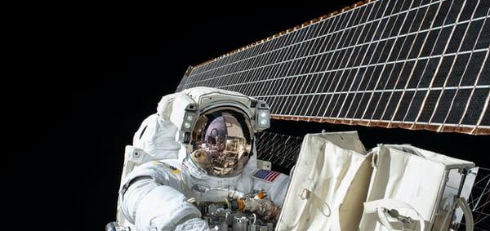
A picture is worth a thousand words
ARCHITECTURE DIAGRAM

Slide 6
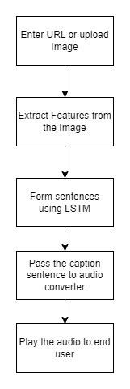
ARCHITECTURE DIAGRAM:

Slide 7
MODULES:
Image Captioning Module
Converting text to speech

Slide 8
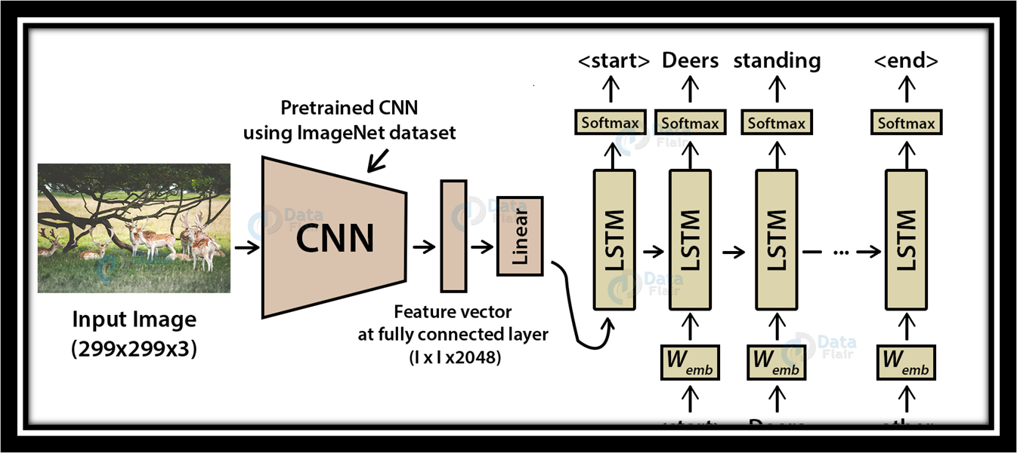
IMAGE CAPTIONING MODULE:
This module takes the image as input, process it with CNN algorithm.
CNN algorithms will capture the features.
LSTM and HuggingFace Transformer will form the description of the image.

Slide 9
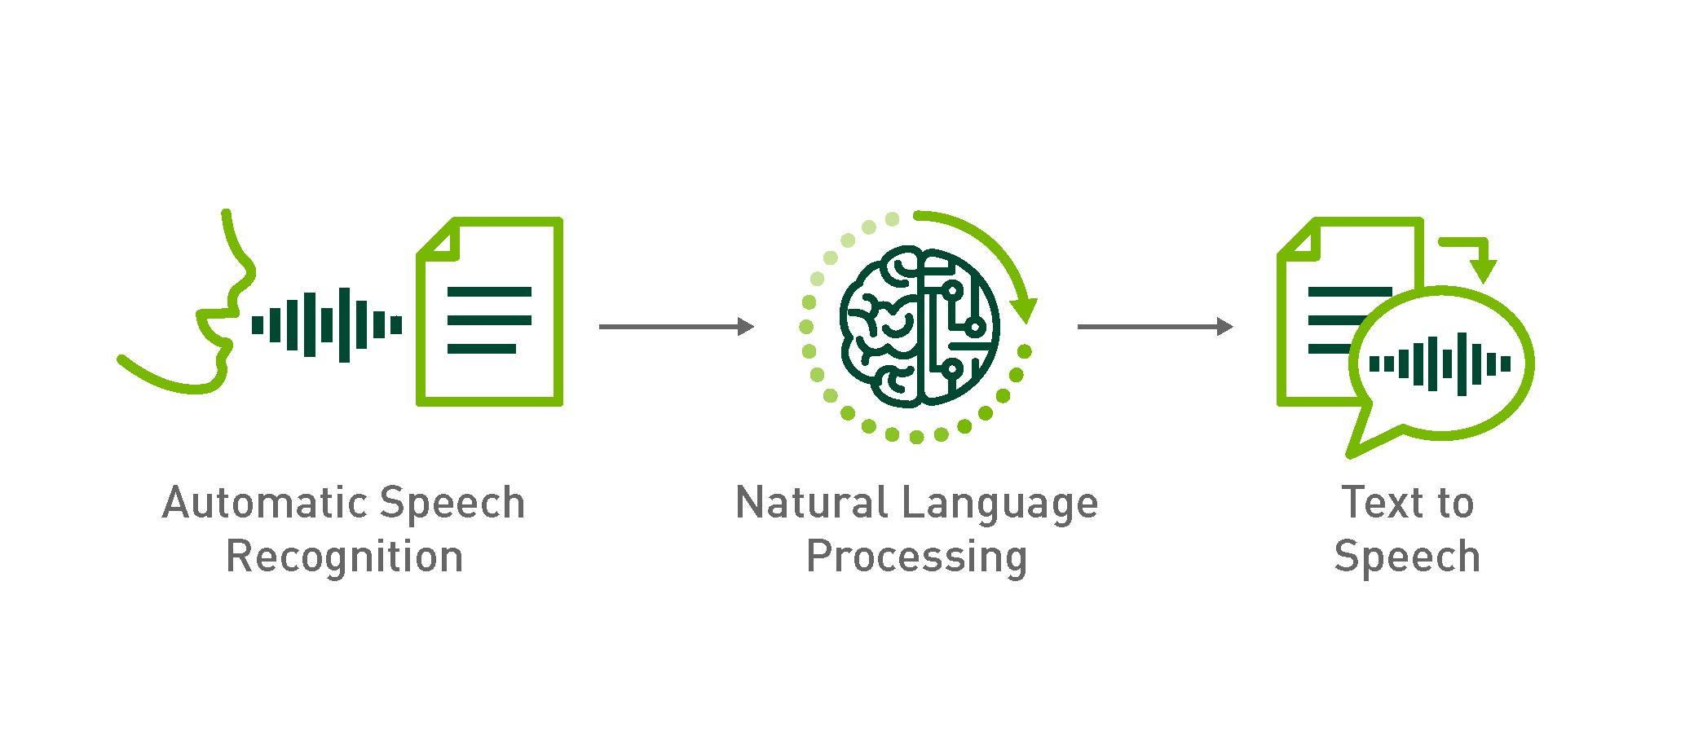
CONVERSION OF TEXT TO SPEECH:
The output which is stored is processed with gTTS library which converts text to speech.

Slide 10
ALGORTIHMS USED:
CNN
HuggingFace Transformer

Slide 11
CNN:
A Convolutional Neural Network (CNN) is a type of deep learning algorithm that is particularly well-suited for image recognition and processing tasks.
It is made up of multiple layers, including convolutional layers, pooling layers, and fully connected layers.

Slide 12

HuggingFace Transformer
Hugging Face Transformers is an open-source Python library that provides a simple and easy-to-use interface for using pre-trained language models, such as BERT, GPT-2, and RoBERTa, for a variety of natural language processing tasks, such as sentiment analysis, named entity recognition, and question-answering

Slide 13
TECHNOLOGY STACK:
PYTHON
LIBRARIES USED:
gTTS
Pandas
Numpy
Tensorflow
Pickle

Slide 14
DATASET USED:
FLickr Dataset – Dataset folder which contains 8091 images.
Flickr_text – Dataset folder which contains text files and captions of images.

Slide 15
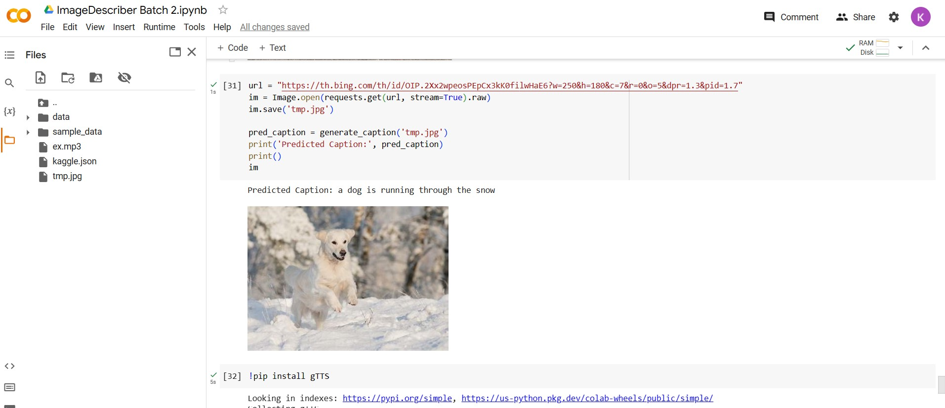
OUTPUT SCREENSHOTS

Slide 16
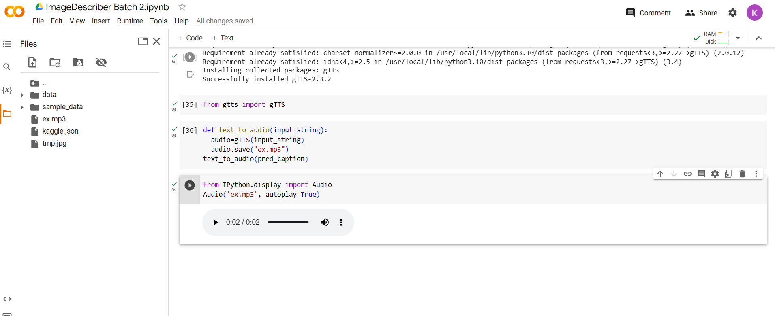

Slide 17
CONCLUSION AND FUTURE WORKS:
The system discussed is designed to be helpful to visually impaired people by translating images to them as audio. People from any background can use Image Describer with ease.
We are planning to release Image Describer as a web or mobile application in the future.

Slide 18
REFERNCES:
[1] Shivangi Nagdewani, Ashika Jain “A Review on methods for Speech-To-Text and Text-To-Speech Conversion”,IRJET MAY-2020
[2] Grishma Sharma, Priyanka Kalena, Aromal Nair, Nishi Malde, Saurabh Parkar “Visual Image Caption Generator Using Deep Learning”,ICAST-2019
[3] Sepp Hochreiter, Jurgen Schmidhuber “Long Short-Term Memory” Neural Computation 9(8):1735:1780, 1997
[4] Itunuoluwa Isewon, Jelili Oyelade, Olufunke Oladipupo “Design and Implementation of Text To Speech Conversion for Visually Impaired People” ,IJAIS-2014
[5] Megha J Panicker, Vikas Upadhayay, Gunjan Sethi, Vrinda Mathur “Image Caption Generator”,IJITEE-2021
[6] O'Shea, Keiron & Nash, Ryan “An Introduction to Convolutional Neural Networks ” ArXiv e-prints-2015.

Slide 19
THANK YOU!

